Slide 1





Spatial Analysis of Vacant Properties in Baltimore
GES 777 Public and Crowdsourced Spatial Data
Krishna C. Mummadi ( MT68291)

Slide 2



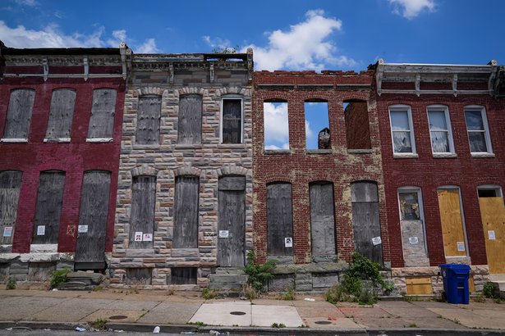



Introduction
Urban vacancy is a persistent issue in many post-industrial U.S. cities
It is a symptom and driver of neighborhood decline
As of 2025, the city reports 12,376 vacant properties across Baltimore.
Picture: The Baltimore Banner

Slide 3





Motivation
While traveling through different parts of Baltimore City, I frequently observed boarded and closed properties.
They contribute to:
Lower neighboring property values
Increased vandalism, dumping, and crime
Reduced tax revenue -> fewer public services
Negative neighborhood perception -> resident out-migration
Vacancy is deeply connected to equity, safety, housing stability, and economic opportunity.

Slide 4



Do high vacancy areas also have:
Higher rates of poverty?
Lower median incomes?
Higher racial segregation?
Higher crime rates?
Can spatial data help identify neighborhoods that need priority reinvestment?
Research Questions

Slide 5


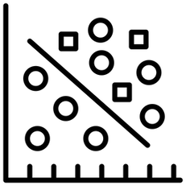

Audience
Baltimore City Department of Housing & Community Development
Real Estate Developers and Investors
Community Organizations and Nonprofits
Residents and Students
My study adds value by:
Performing spatial statistical analysis
Highlighting socio economic correlations
Visualizing vacancy patterns citywide
Indentifying Investing locations

Slide 6
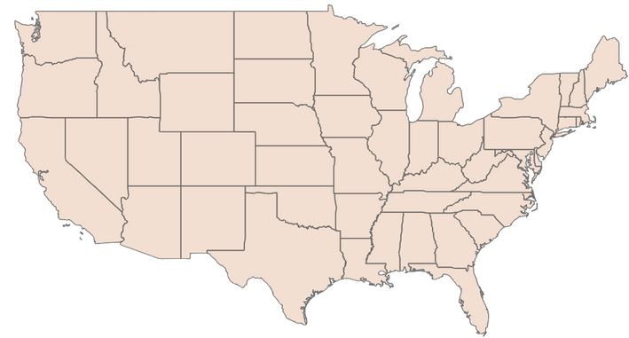
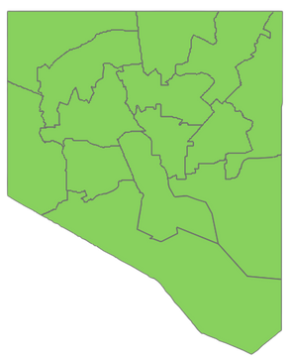
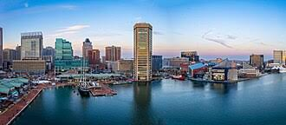

Geographic Area: Baltimore City
Baltimore City, central Maryland (population approx 568,271, 2024 U.S. Census bureau).
Analysis uses 199 census tracts, allowing neighborhood-level spatial analysis.
Census Tracts are small geographic units that reveal localized patterns, and they are reliable because they include ACS demographic and socioeconomic estimates.

Slide 7
Baltimore City Department of Housing and Community Development (DHCD) - Vacant Building Notices
Baltimore City Open Data Portal
Part 1 Crime Data (2023–2025)
311 Service Requests (Illegal Dumping, Litter, Sanitation; 2023–2025)
Public Transit Stops (Bus and Rail)
Schools (Public and Private)
Universities and Colleges
U.S. Census Bureau
American Community Survey (ACS) Demographic and Socioeconomic Data
Census Tract Boundaries
Maryland Department of Planning / State Department of Assessments and Taxation (SDAT)
Parcel and Building Footprint Data
Data Sources

Slide 8
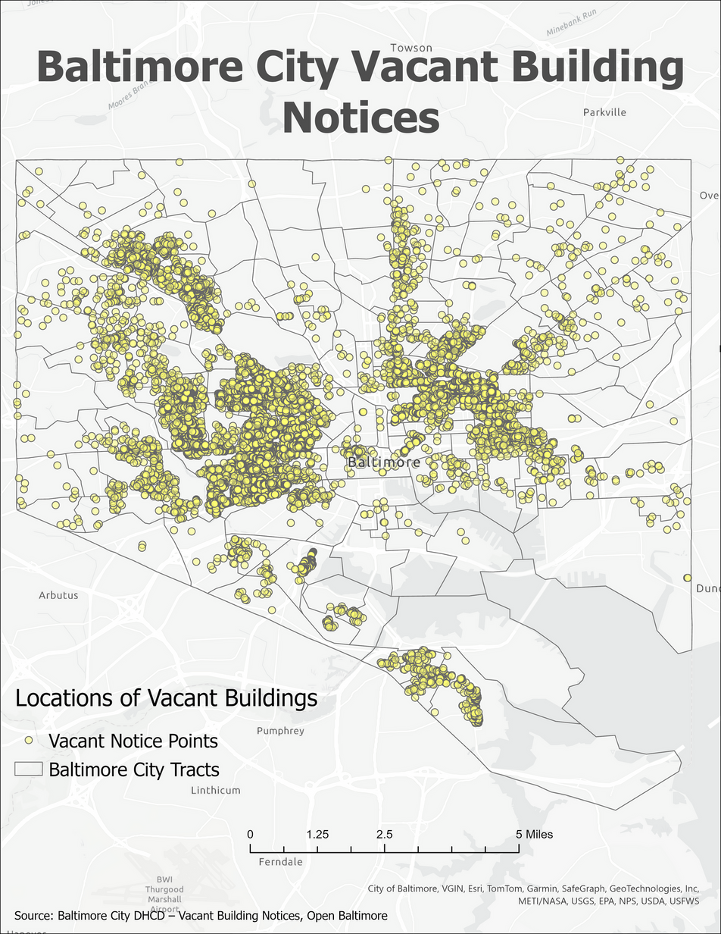
Vacant Building Notices (Points Map)
Shows the location of all recorded vacant building notices in Baltimore City.
Vacant properties are concentrated in West Baltimore and parts of East Baltimore.
Northern and southeastern neighborhoods show fewer vacant buildings.

Slide 9
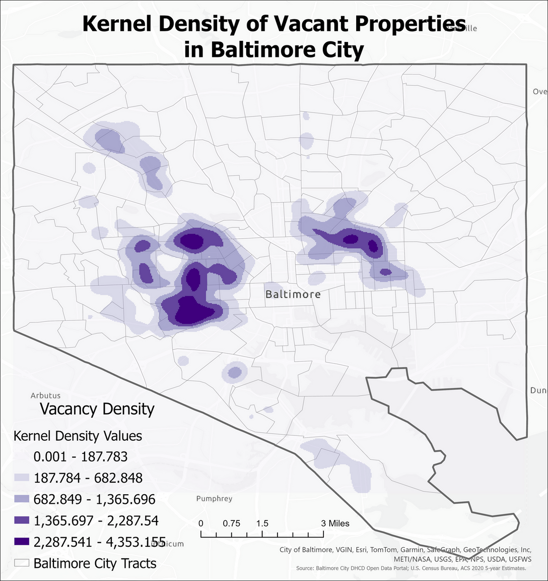
Kernel Density of Vacant Properties
The map displays clusters of high vacancy density across the city.
Strong hotspots appear in West Baltimore and Central East Baltimore.
Smaller secondary clusters appear in Southwest Baltimore.
Low-density areas are found in North Baltimore and along the waterfront.
Highlights neighborhoods with the most intense vacancy pressure.

Slide 10
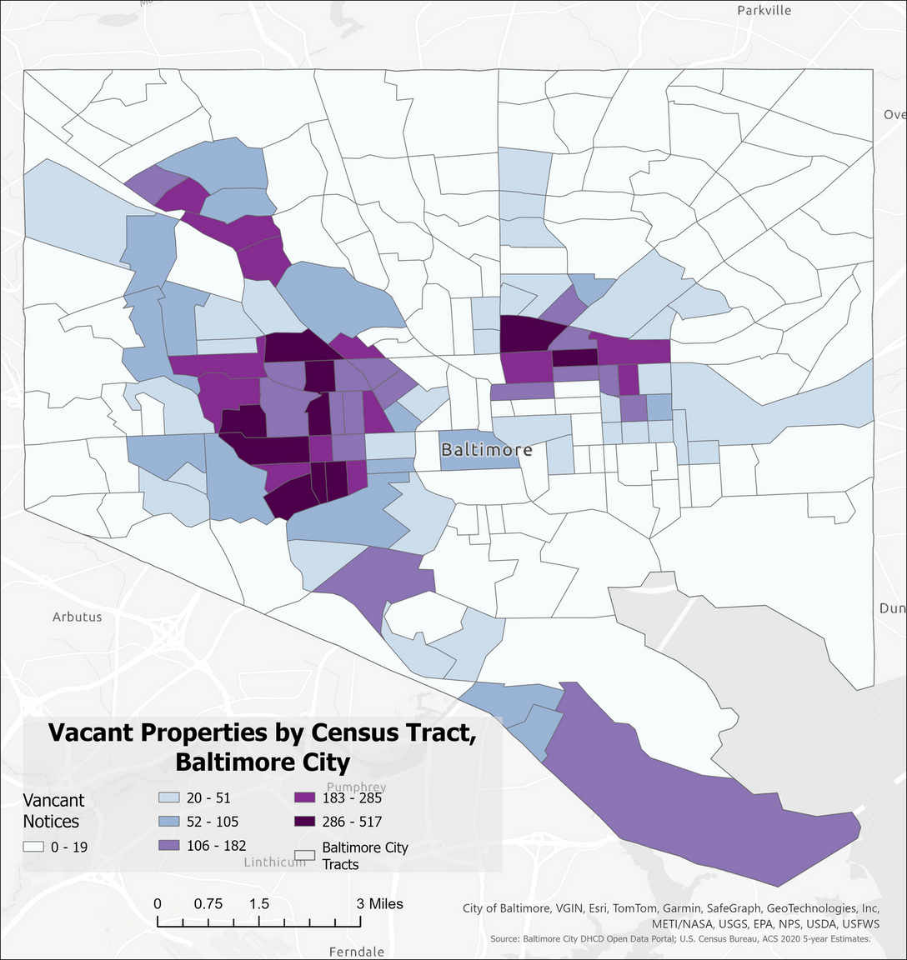
Vacant Properties by Census Tract (Counts)
Shows the total number of vacant buildings within each census tract.
Highest counts occur in tracts in West Baltimore and parts of East Baltimore.
Many northern and south-central tracts have very low or no vacancy.
Reveals large geographic differences in neighborhood conditions.

Slide 11
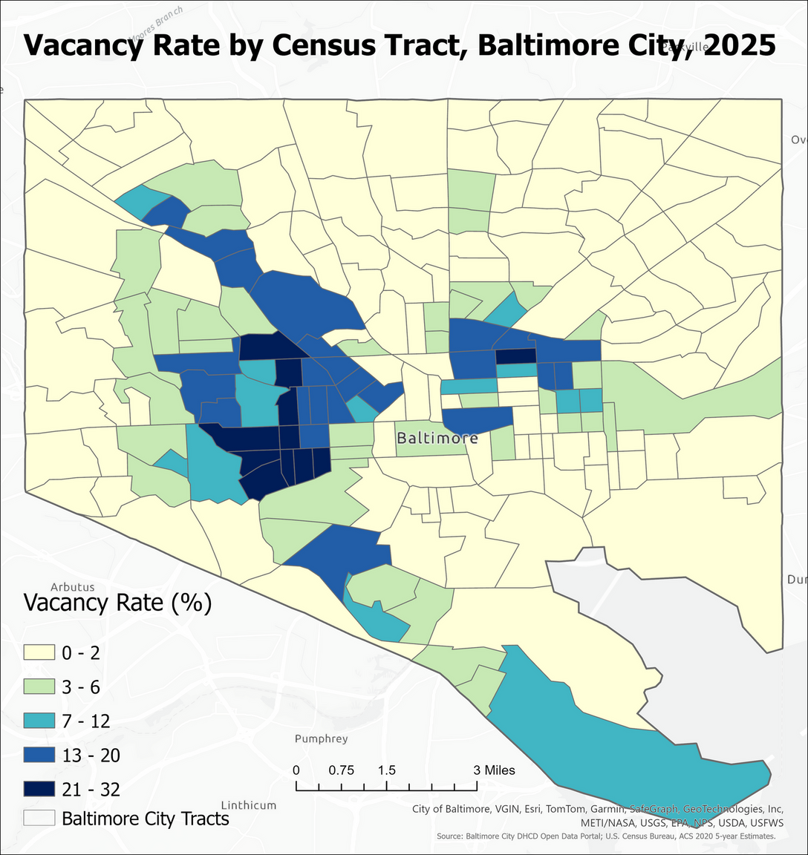
Vacancy Rate by Census Tract
Shows vacancy as a percent of total housing units, not just raw counts.
High vacancy rates are concentrated in West Baltimore and Central East Baltimore.
Lower vacancy rates occur in the northern and southeastern parts of the city.
Highlights neighborhood housing distress more clearly than raw counts.
Vacancy Rate=Total Property Count/Vacant Property Count​×100

Slide 12
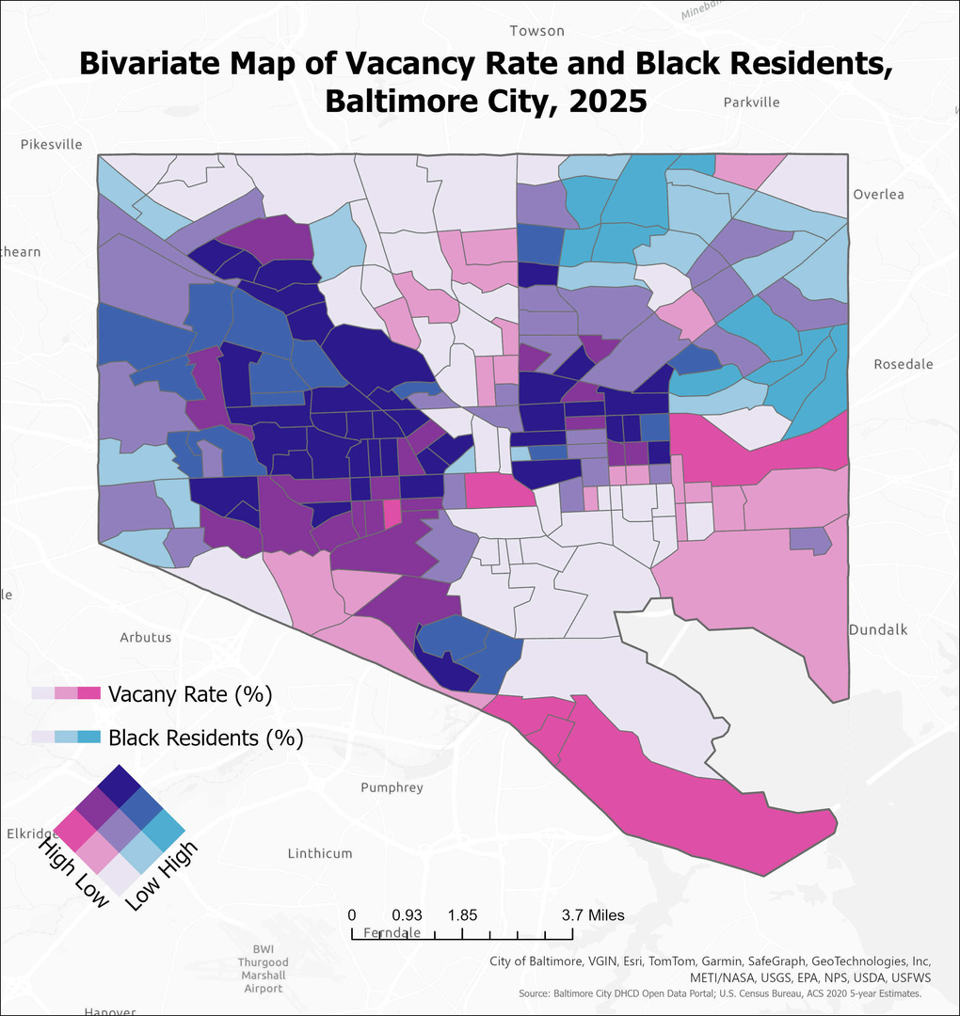
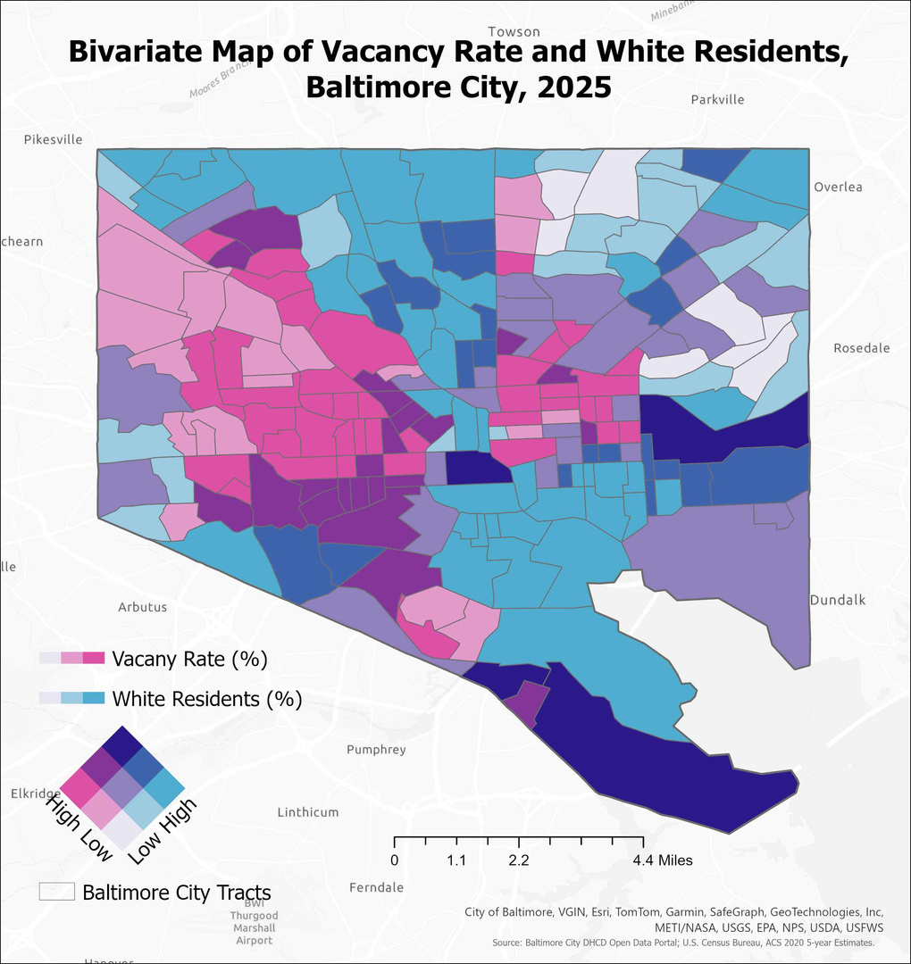

Slide 13
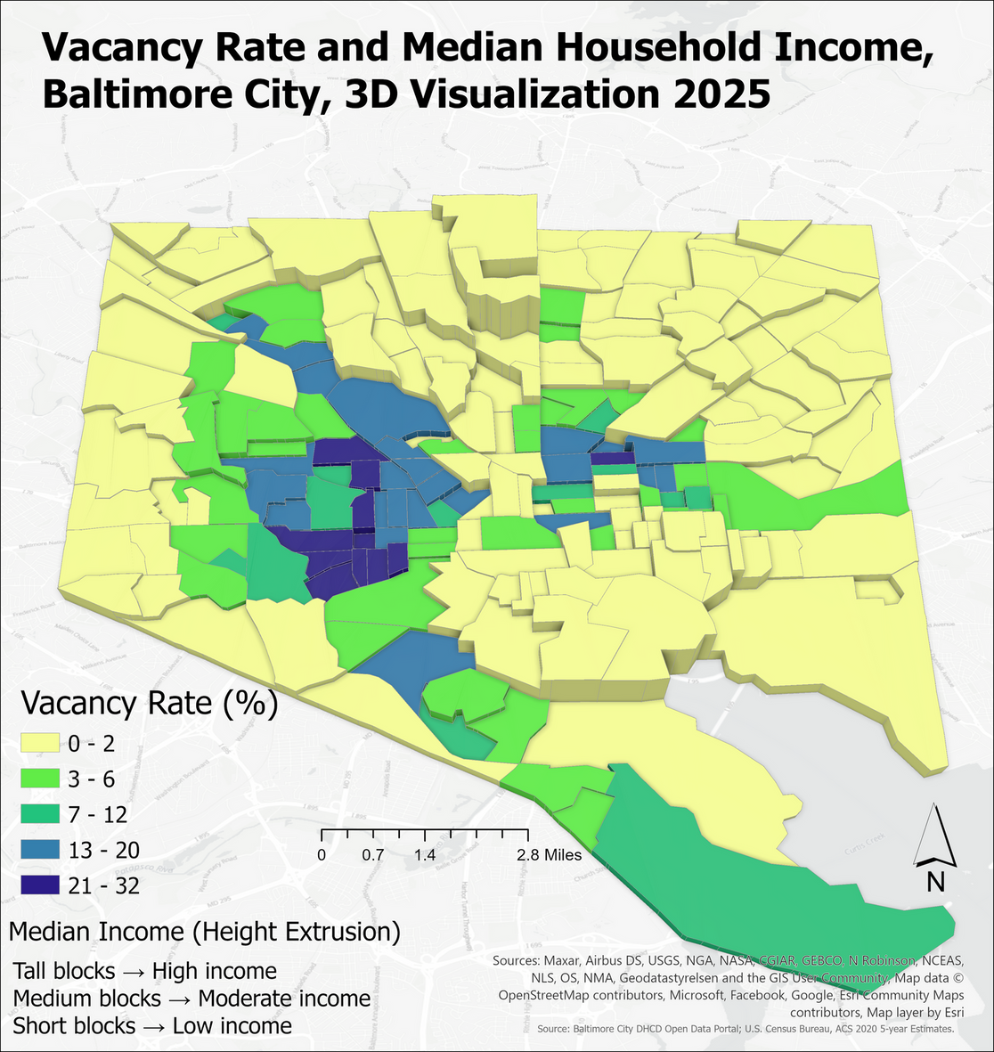
Height of each tract reflects median household income.
Color represents vacancy rate.
Low income tracts with high vacancy appear as short blocks with darker colors.
High income areas appear as tall blocks with low vacancy.
Shows the strong connection between low income and high vacancy.

Slide 14
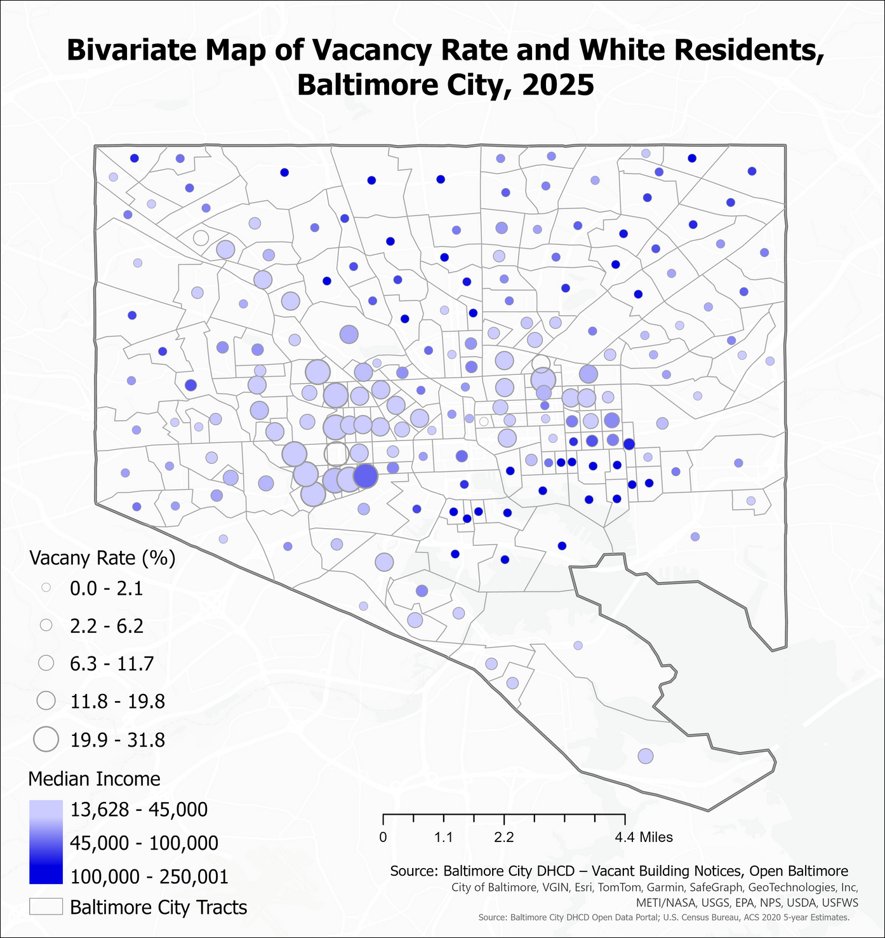
Proportional Symbol Map:
Vacancy and Income
Circle size shows the number of vacant buildings in each tract.
Color shows median household income.
Large circles in light colored tracts indicate high vacancy and low income.
Smaller circles in darker tracts indicate low vacancy and higher income.
Illustrates income and vacancy patterns in a single view.
Notes:
Vacant areas, highest potential for development, Choropeth maps,
15

Slide 15
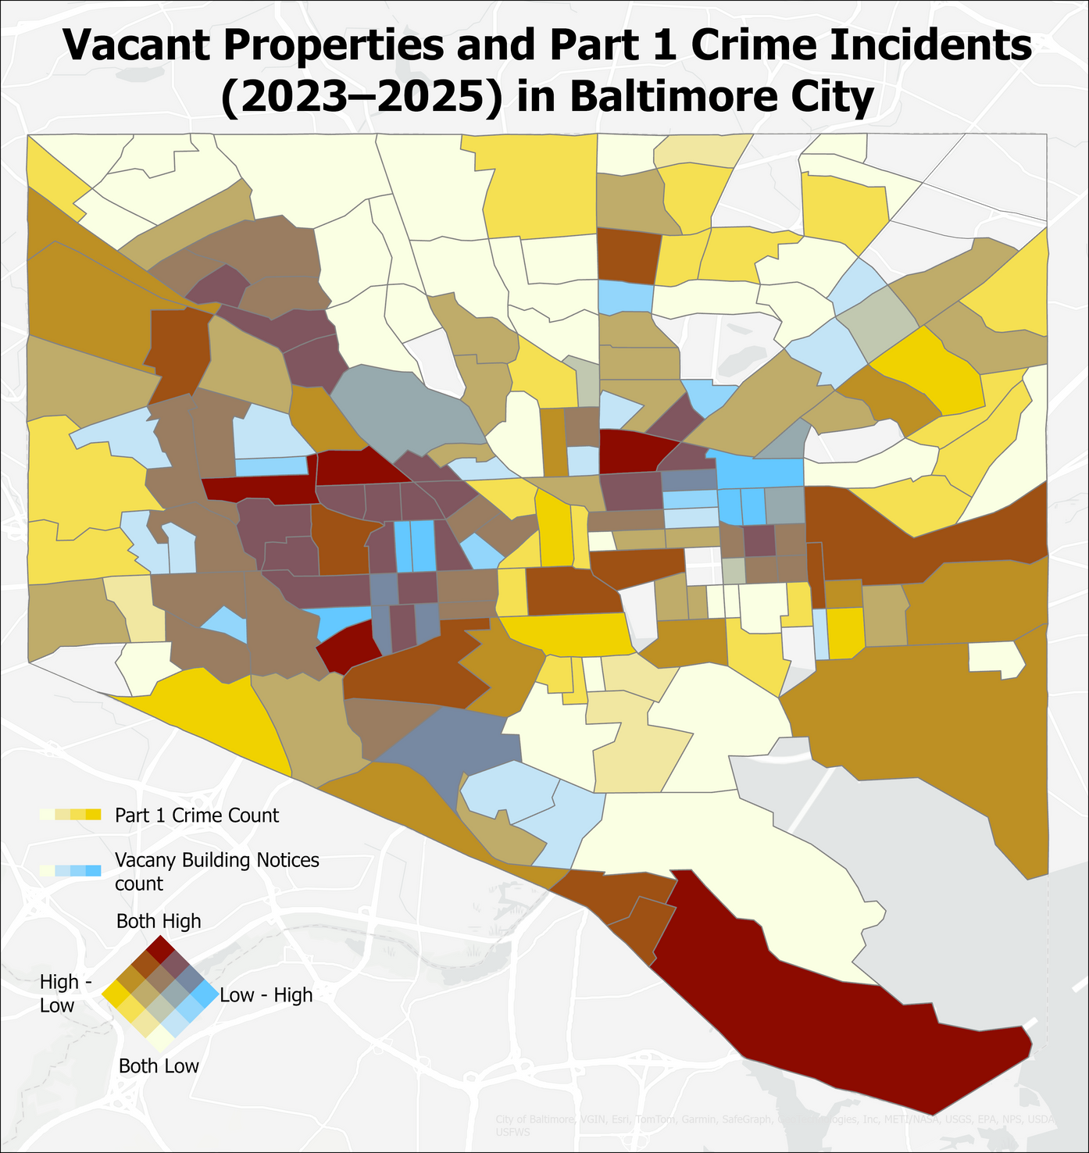
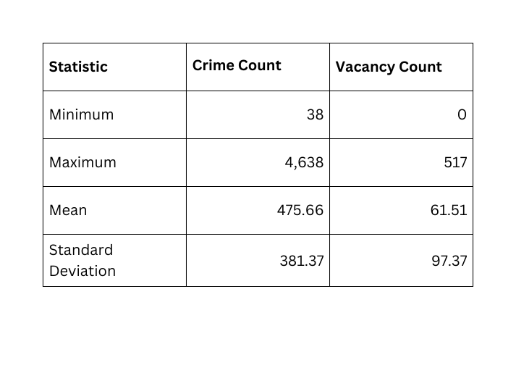
Neighborhoods with high vacancy and high crime rates include
Millhill
East Baltimore Midway
Mount Clare
Mondawmin.
Source: Part 1 Crime Data (Legacy SRS), Baltimore city

Slide 16
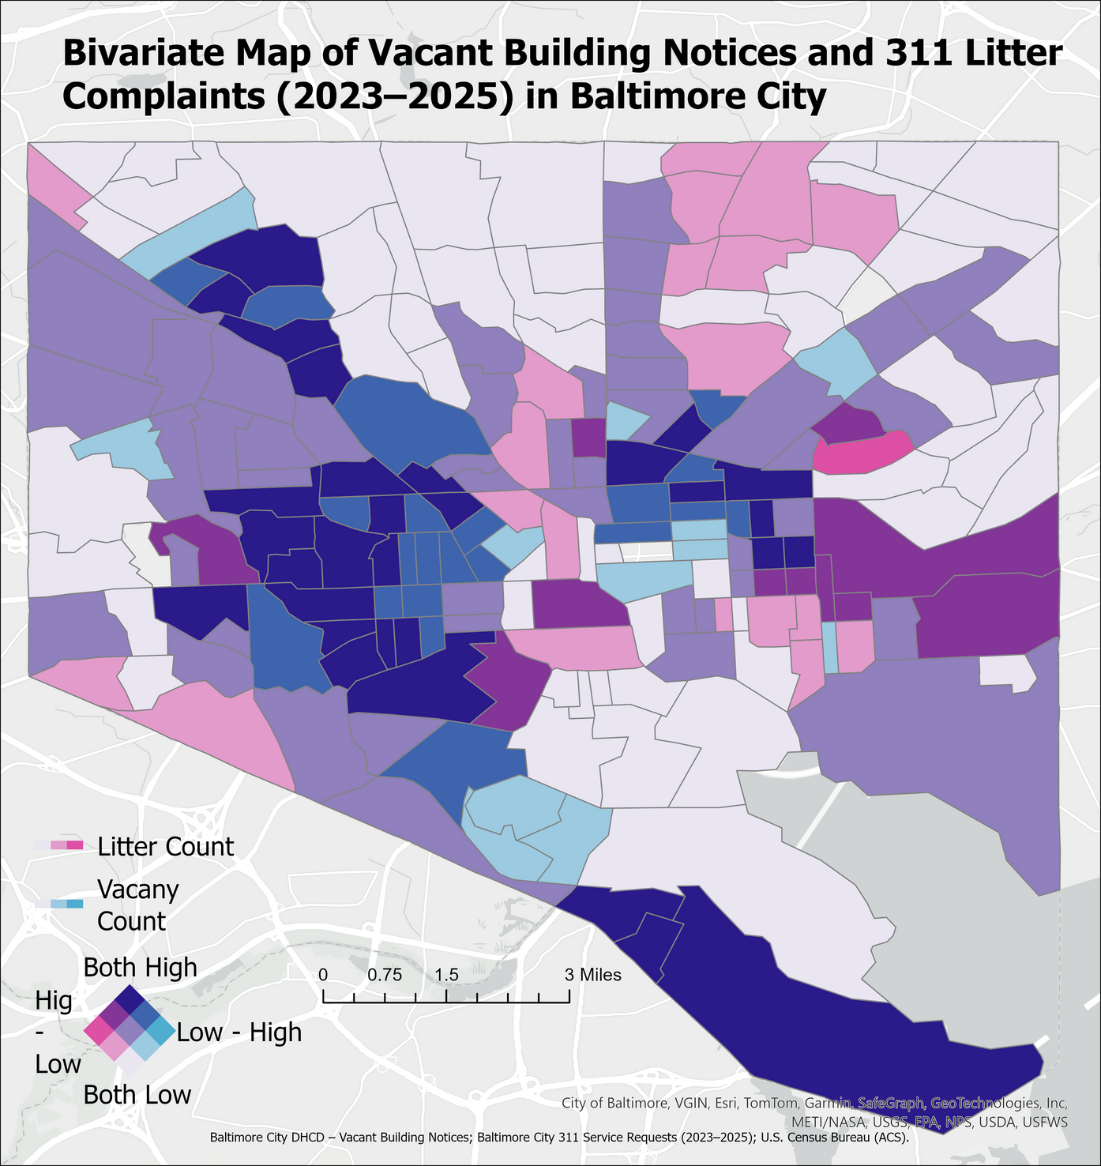
Census tracts with high numbers of vacant buildings also show high levels of litter and sanitation-related 311 complaints.
Concentrations are observed in West Baltimore and parts of Central and East Baltimore.
Tracts with low vacancy generally report fewer litter complaints, indicating more stable neighborhood conditions.
The spatial overlap suggests that vacant properties contribute to environmental disorder, including illegal dumping and sanitation issues.
Litter complaints are more dispersed than vacancy, but the highest concentrations align with major vacancy clusters.
311 Litter categories used here
HCD – Illegal Dumping
HCD - Sanitation property
SW – Dirty Alley
SW – Dirty Street
SW – Public (Corner) Trash Can Issue
SW – Public (Corner) Trash Can Request / Removal

Slide 17
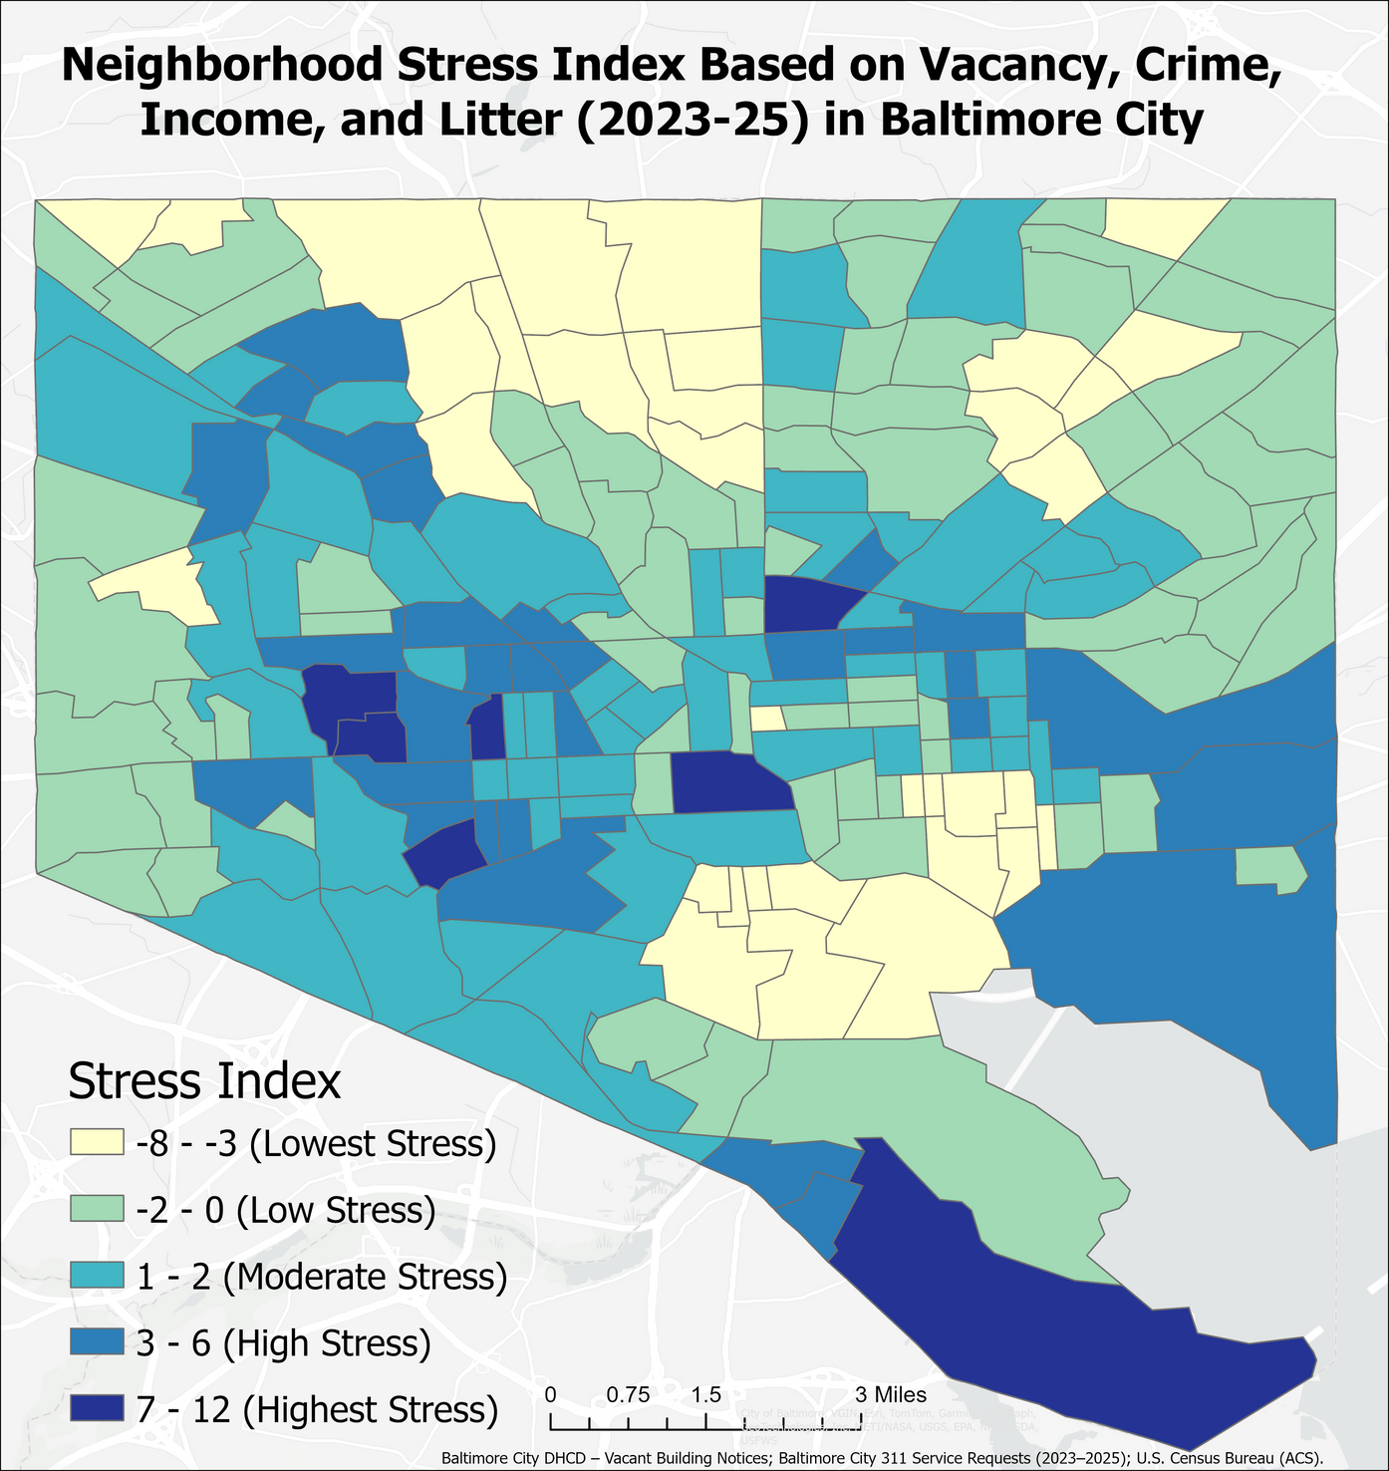
Neighborhood Stress Index
The neighborhood stress index highlights census tracts experiencing cumulative challenges related to housing vacancy, crime, low income, and environmental disorder.
z-score :
z=(x−mean)/standard deviation
For median income, the z-score values are inverted as Higher income = better condition and lower income = more stress
Stress index = !z_vacancy! + !z_crime! + !z_litter! + !z_income_inv!
High-stress clusters appear clearly in:
West Baltimore
Parts of East Baltimore
South Baltimore waterfront edge

Slide 18
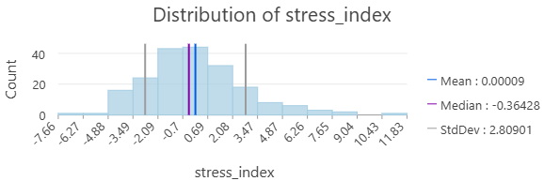
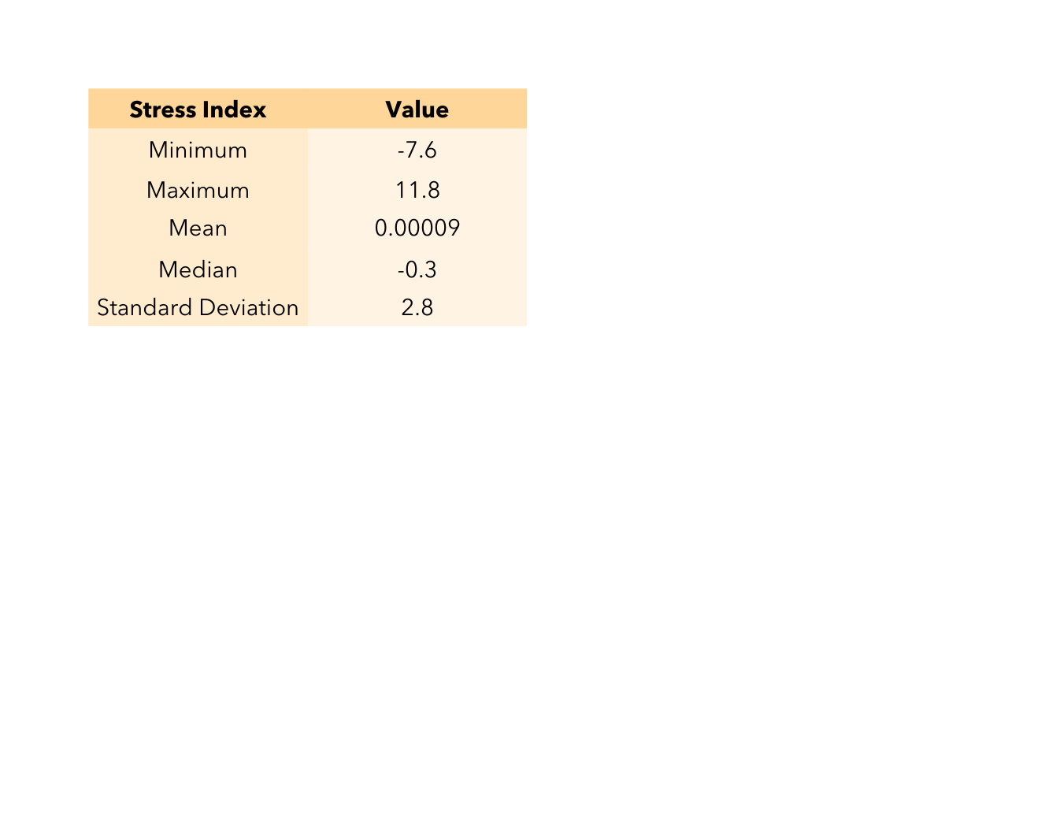
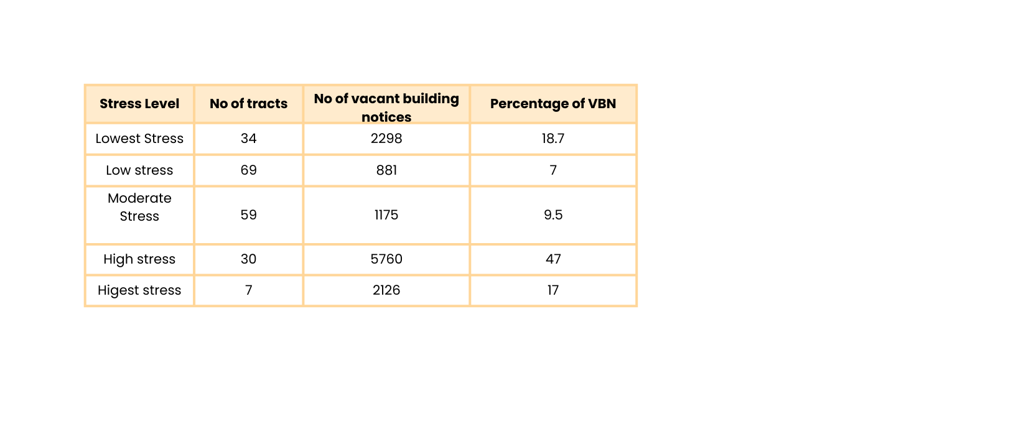

Slide 19




Baltimore City Department of Housing & Community Development already tracks vacancy through programs like:
Developer Analysis Question
Which vacant properties are located in neighborhoods with manageable crime levels, moderate income conditions, lower environmental disorder, and good access to transit and educational institutions?
Provide the ranking to the vacant buildings as perthe opportunity

Slide 20
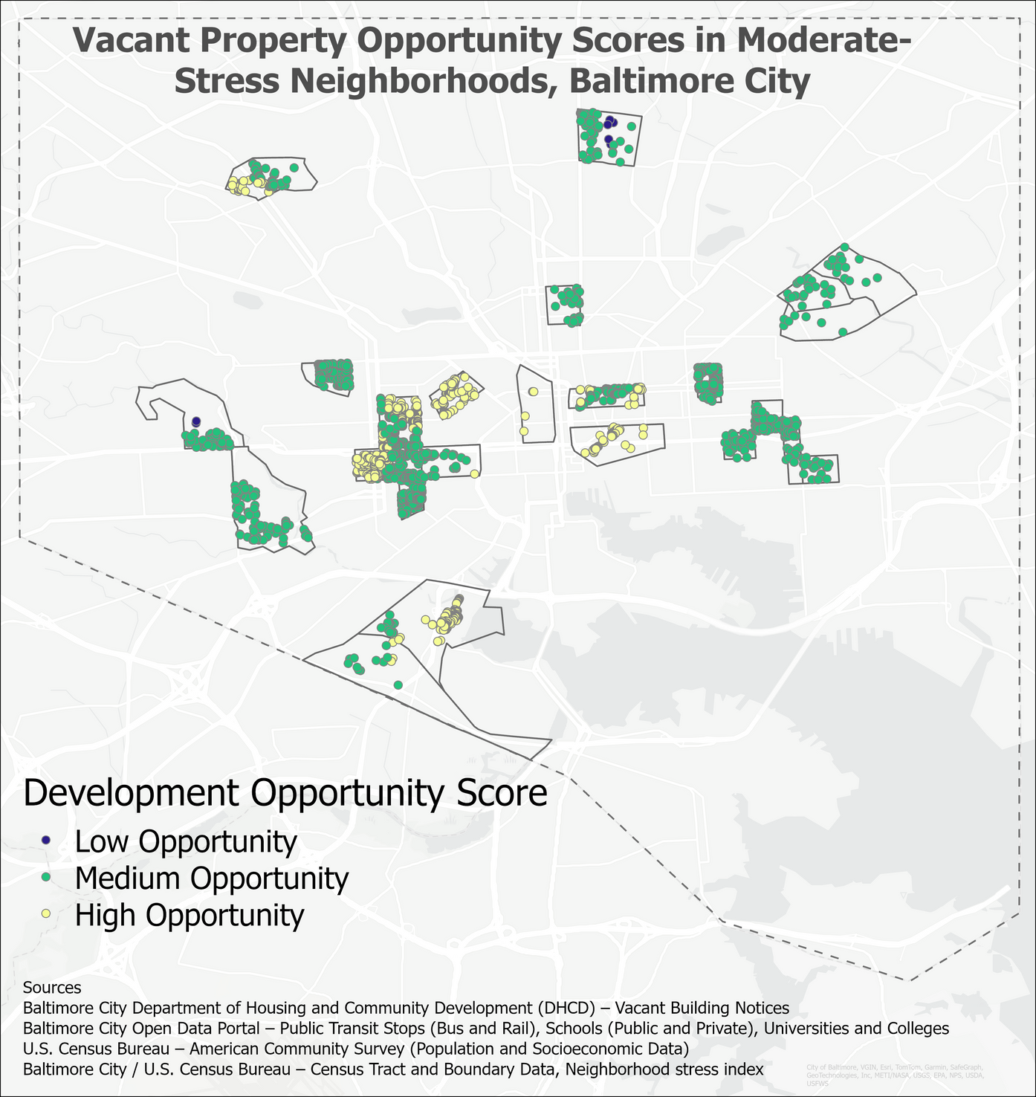
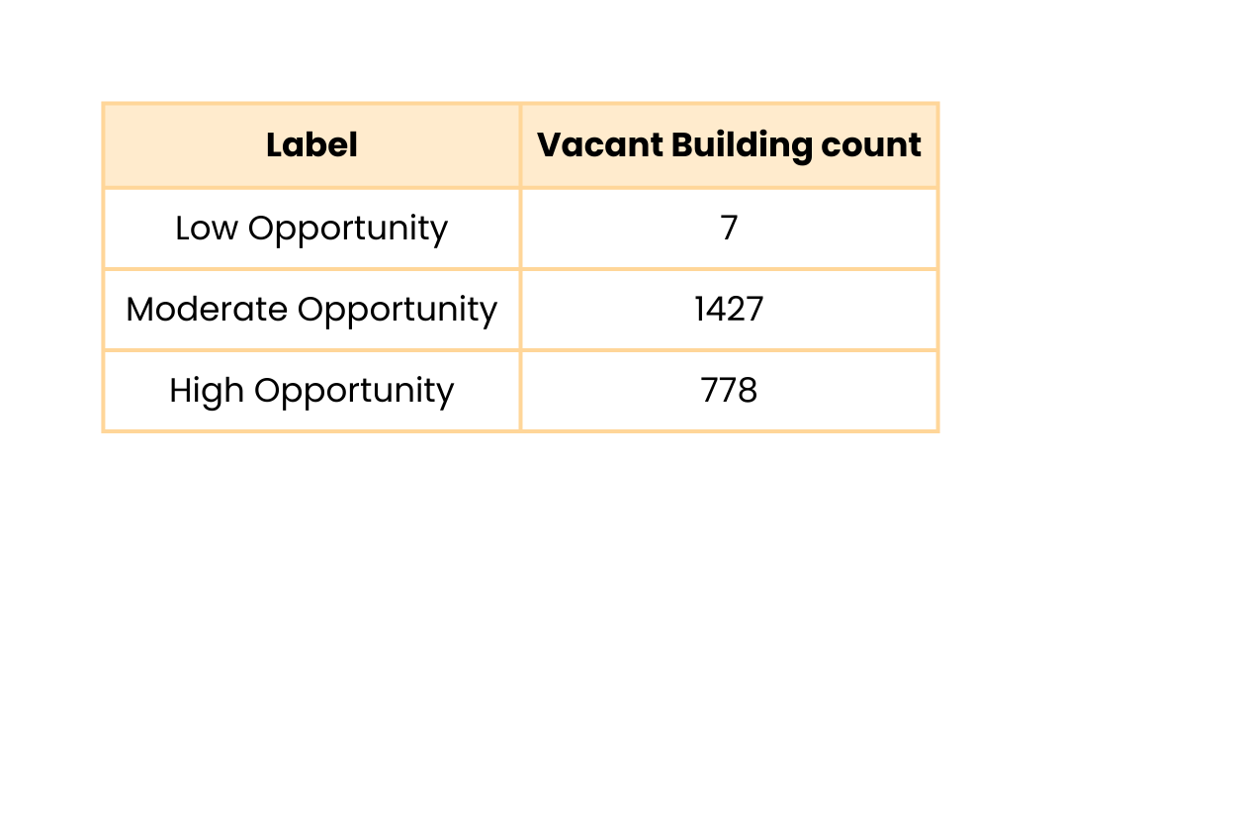
Methodology
Selected the moderate stress tracts
filtered the vacant building notices in the moderate tracts( 2212 of 12240)
Added the bus and rail stops, the University, the college, and the school locations
Bustations with 0.25 mile buffer
Rail stations with 0.5mile buffer
Educational institutions with 1 mile buffer
Central Park Heights
Kenilworth Park
Belair-Edison
Barclay
Edgewood
Sandtown - WInchester
Midtown Beledere
Middle East
Johnston Square
Petterson Park Nghbd
Penrose/Fayette Street
Poppleton
Baltimore Highlands
Oldtown
Mount Clare
Carroll-South Hilton
Franklin square
Westport
Lakeland

Slide 21

Thank You
Notes:
Schools, education, high/low employment,
16

